Slide 1

Quantum Computing
A Hands-on Experience with Jupyter Notebooks

Slide 2
History
Co-Directors
Andrew MacLean
Ulrike Stege
Started in 2017/18
Out of Department of Computer Science
First cohort of our Skills Academy in 2018
Software development
2019
2 cohorts
2020
Next cohort starts Saturday, Feb 1
Summer skills academy—computer engineering

Slide 3
Workshops
Brand-new addition to HighTechU
Plan: regular offerings of workshops
Today: Quantum Computing: A Hands-on Experience with Jupyter Notebooks
March 2020: 2-day Workshop on Quantum Computing

Slide 4
Today’s HighTechU Q Team
Priya Angara
Hausi Müller
Ulrike Stege
Sunil Kumar
Andrew MacLean
Ivan Martell

Slide 5
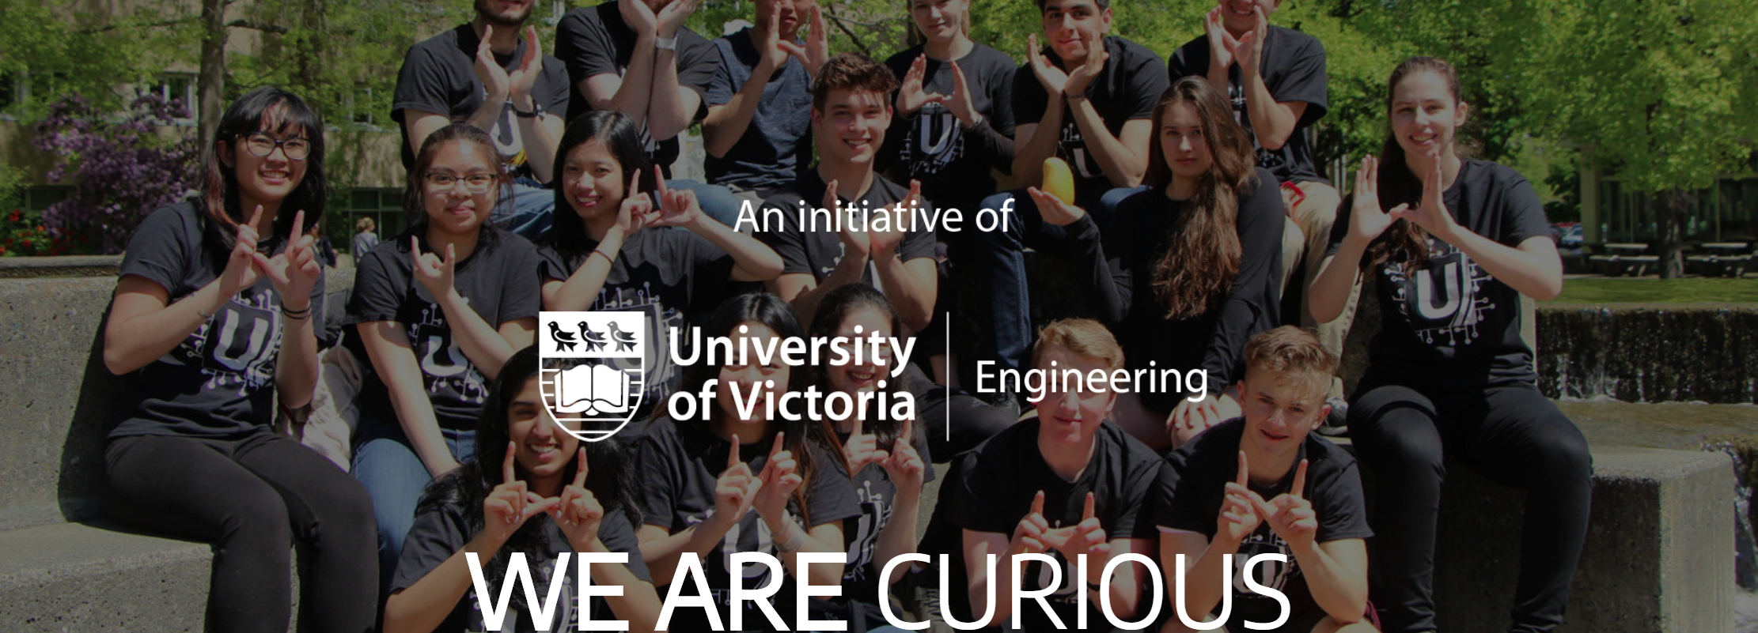
https://hightechu.ca

Slide 6


Slide 7
Today’s Agenda
Starting Time Approximate | Topic
9:00 | Introduction and Motivation
9:30 | Account setup on IBM Q Experience
10:00 | Break
10:15 | Introduction to Jupyter Notebooks, Python, Qiskit
11:00 | Qubits, gates, superposition and measurements
12:30 | Lunch
1:00 | Hands-on programming
2:30 | 2-qubit systems and entanglement
3:30 | Break
3:45 | Entanglion
4:45 | Closing & Feedback

Slide 8
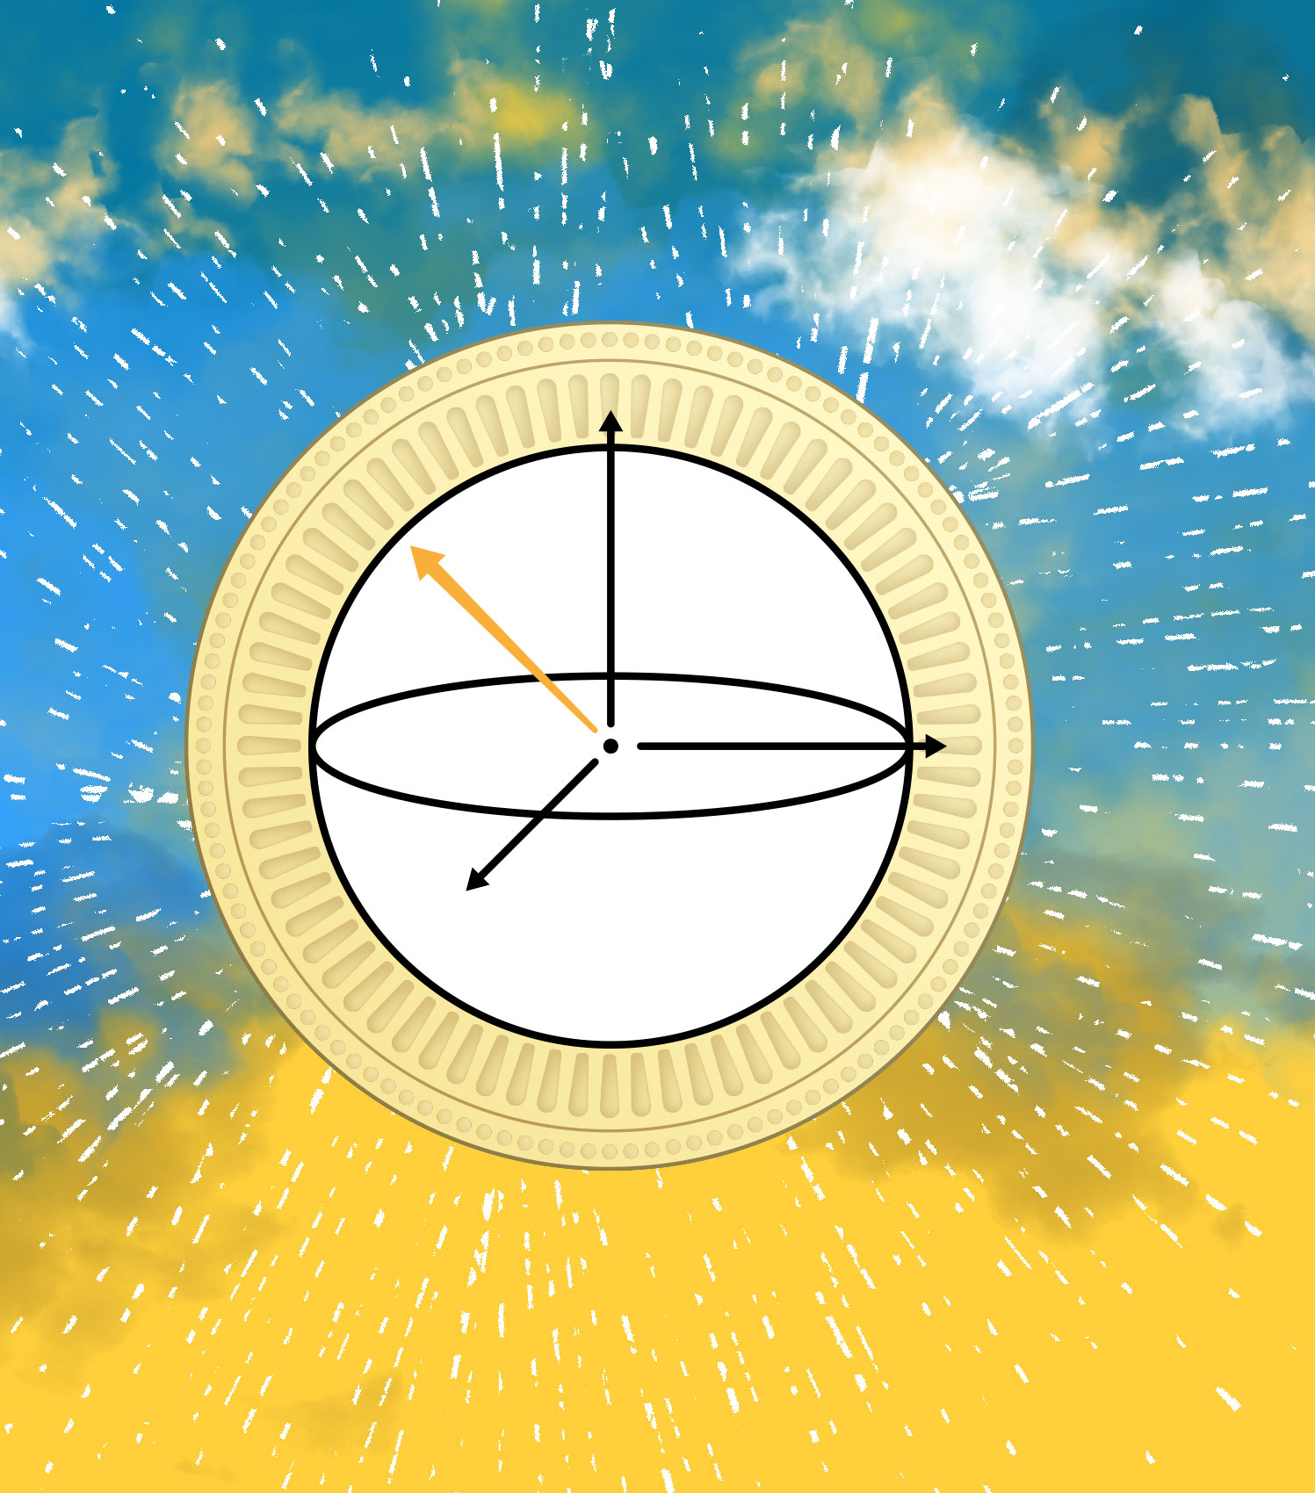
What is Quantum Computing?
Our Sponsors

Slide 9
Nature isn’t classical … and if you want to make a simulation of Nature, you’d better make it quantum …”
—Richard Feynman, CalTech, 1981
Quantum Computing leverages nature to represent and manipulate information

Slide 10
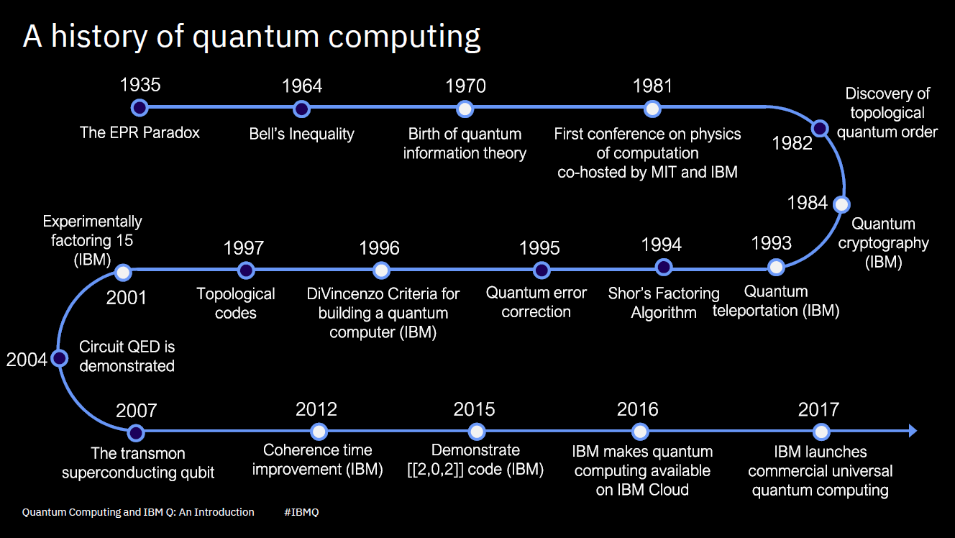


Slide 11
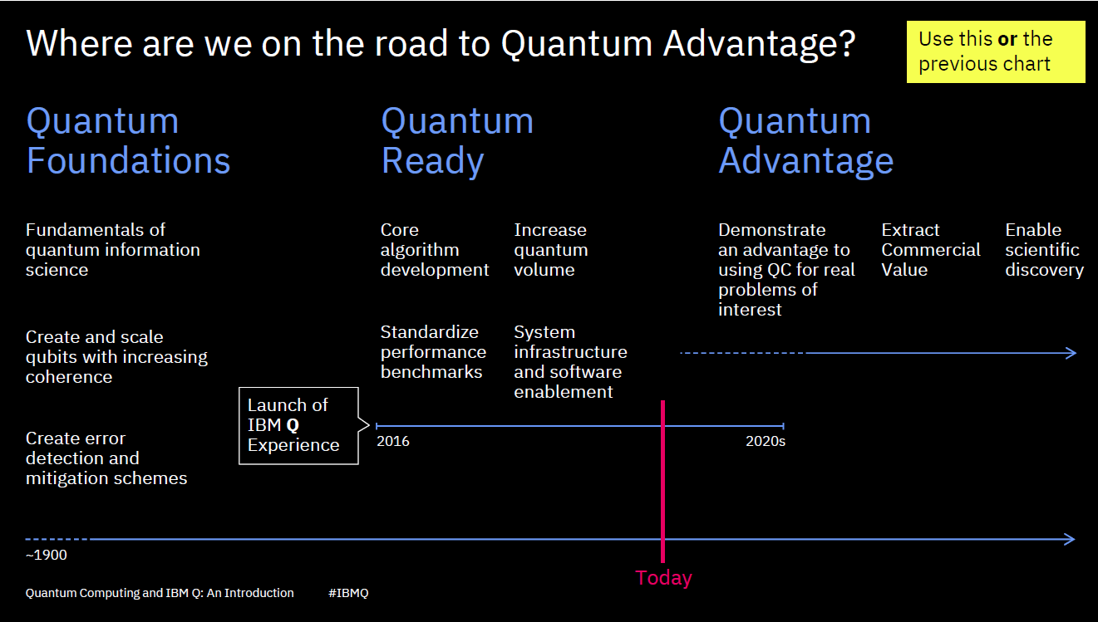

Slide 12
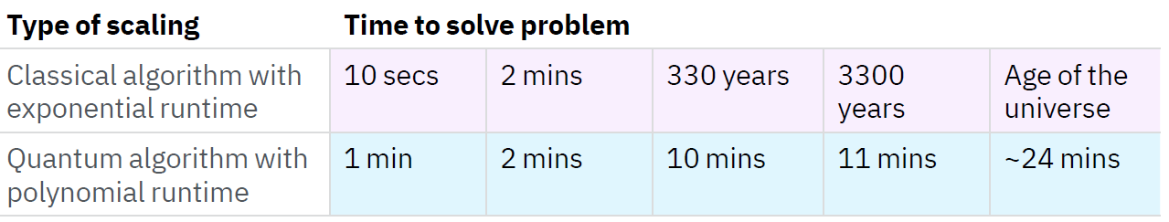
One Form of Quantum advantage
Quantum computers will not replace classical computers
Hybrid quantum-classical architectures will be the norm
Superposition & entanglement allow QC to explore an enormous set of possibilities to find answers
QC’s potential for significant speed over classical computers
Coming soon to your business – Quantum computing
www.ibm.com/thought-leadership/institute-business-value/report/quantumstrategy

Slide 13
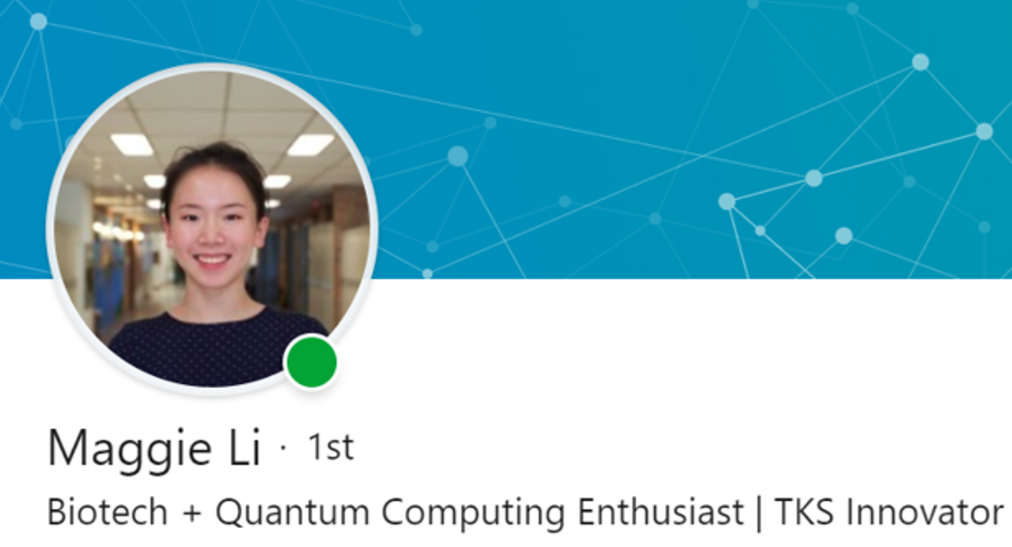
A Wonderful Story of Quantum Computing Applications

Slide 14
Categories of Quantum computers
en.wikipedia.org/wiki/List_of_quantum_processors
Quantum annealing, adiabatic computing
D-Wave Systems
Noisy intermediate-scale quantum computing (NISQ)
IBM, Google, Rigetti, Intel
Fault-tolerant universal quantum computing
Ultimate goal
Manufacturer | Qubits
D-Wave | 512, 1024, 2048
IBM | 5, 14, 20, 53
Google | 53, 72
Rigetti | 128
Intel | 49

Slide 15
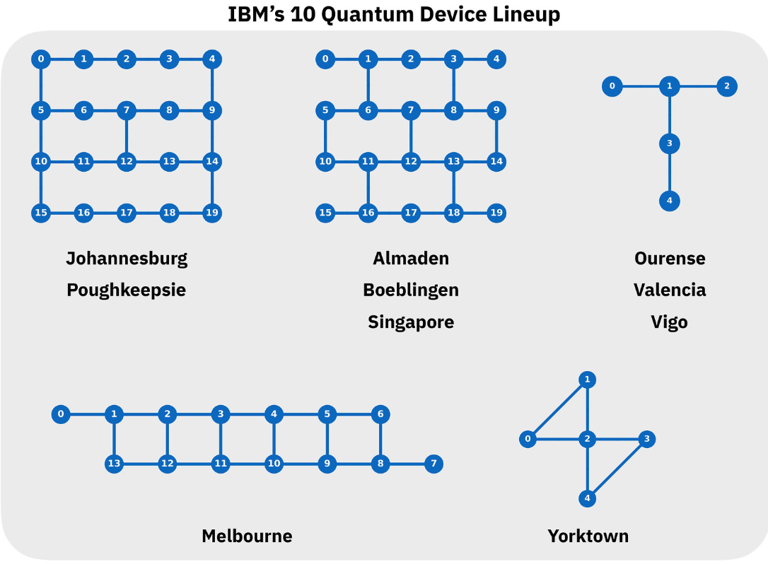
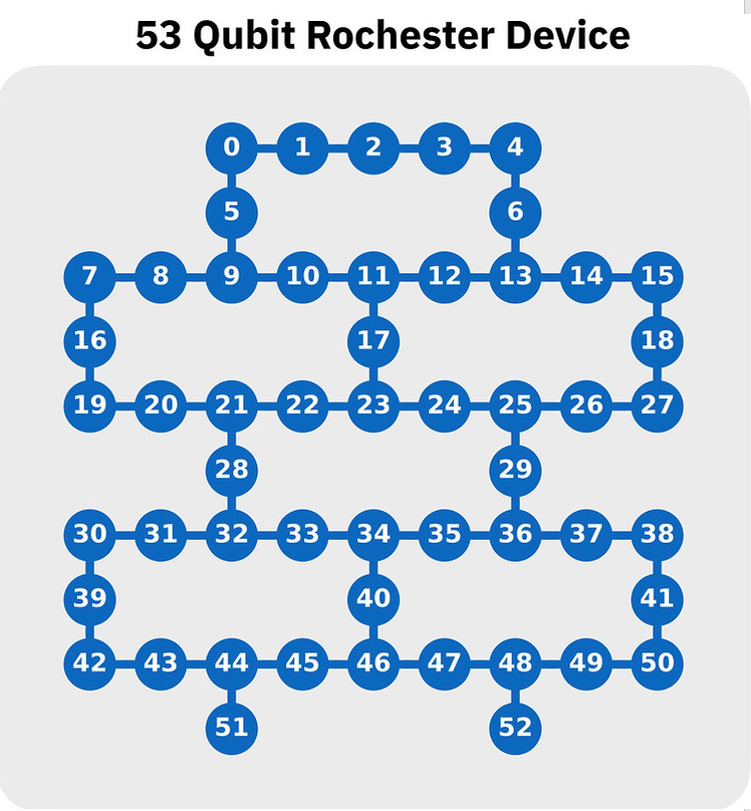
IBM’s online Quantum Devices

Slide 16
Quantum software development kits
IBM
IBM Q — www.research.ibm.com/ibm-q/
Qiskit—Terra, Aqua, Ter — qiskit.org
Microsoft
Q# — www.microsoft.com/en-us/quantum/
Microsoft QDK — en-us/quantum/development-kit
Google
Google-AI — quantum-ai/
Google Cirq — github.com/quantumlib/Cirq
Rigetti
Forest SDK — rigetti.com/forest
D-Wave
Leap — www.dwavesys.com/take-leap
Ocean SDK — ocean.dwavesys.com/
Ready now—for you!
Innovative digital tools are needed for developing and testing algorithms, writing software and programming the devices.
A new breed of quantum programmer is needed to study and implement quantum software
—Zheng, Rigetti: First Quantum Computers Need Smart Software, Nature 549(7671), 2017

Slide 17
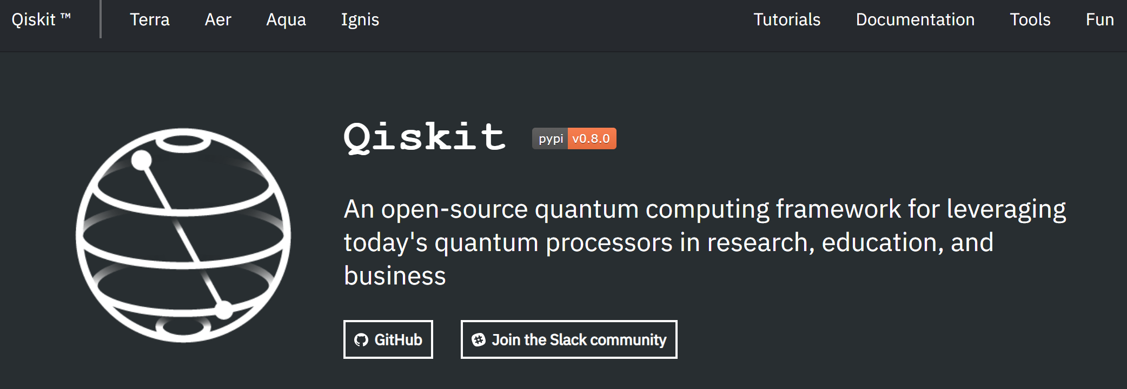
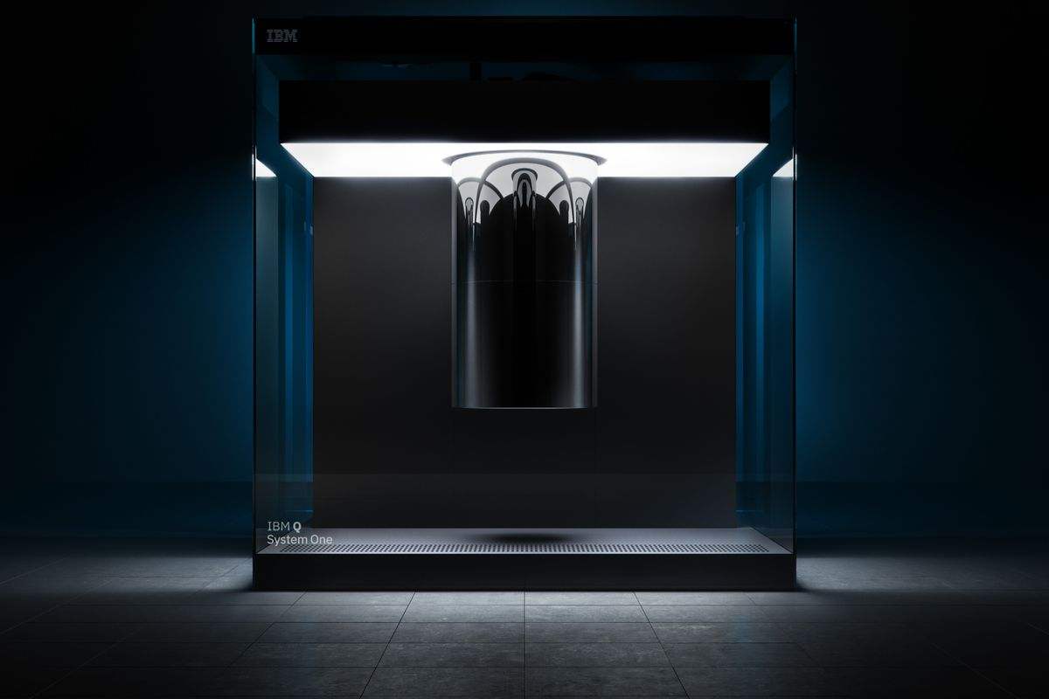
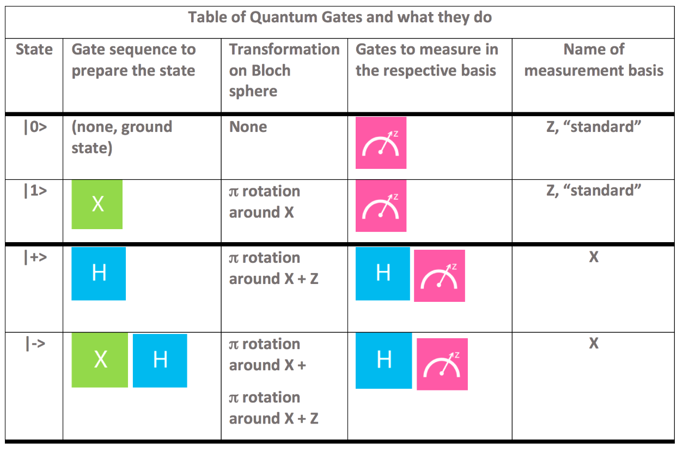
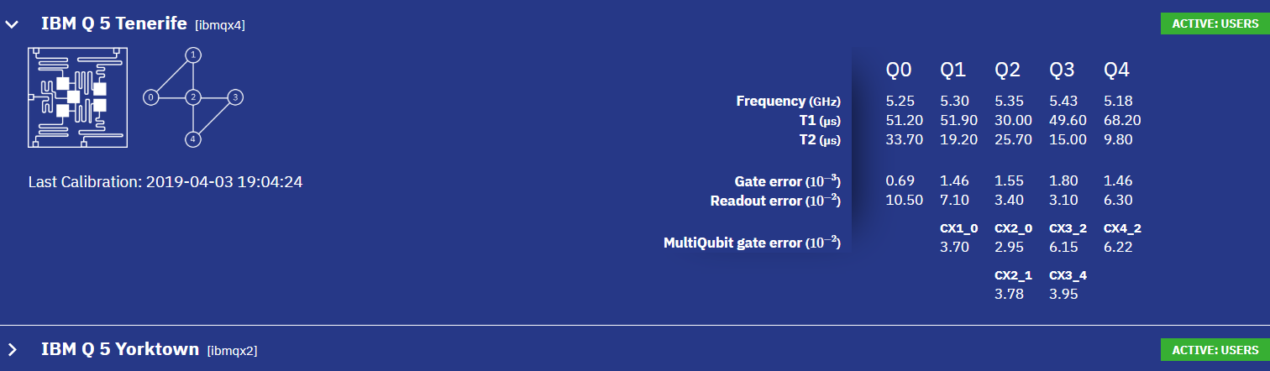
IBM System One — 20 Qubits

Slide 18
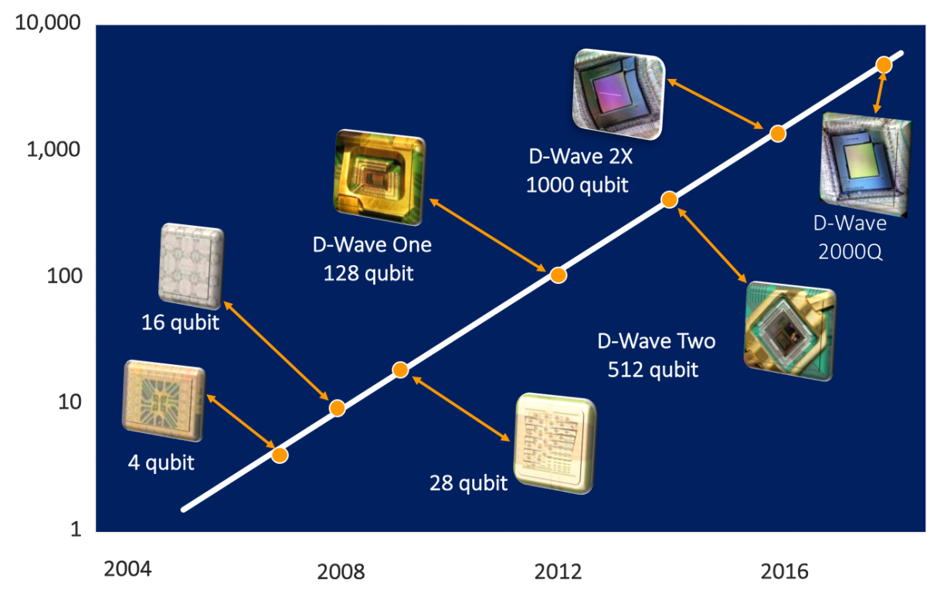
D-Wave Systems & Geordie Rose's Law www.dwavesys.com/resources/tutorials

Slide 19
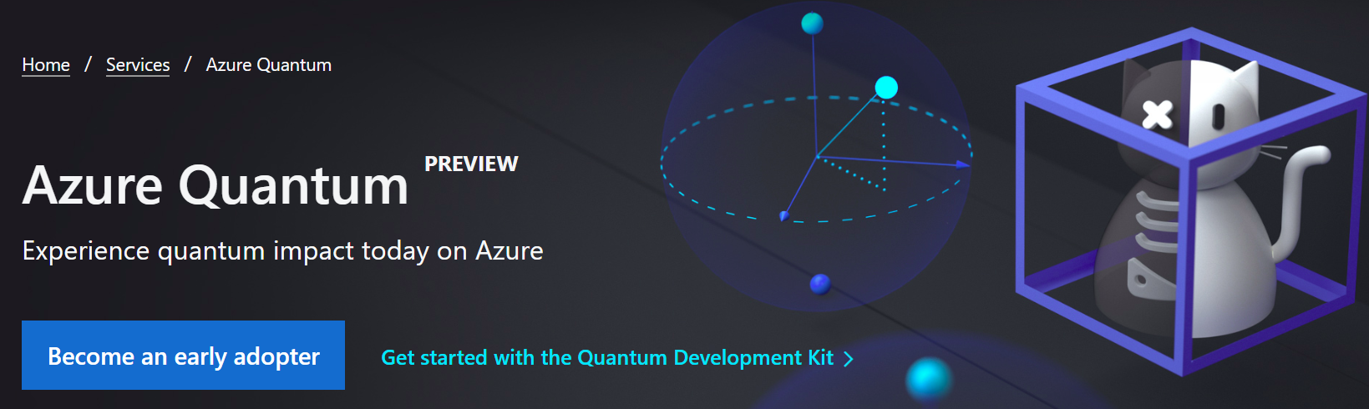
Microsoft Quantum Azure
azure.microsoft.com/en-ca/services/quantum
Azure Quantum is a full-stack, open cloud ecosystem that will bring the benefits of quantum computing to people and organizations around the world.
With partners 1QBit, Honeywell, IonQ, and QCI, Mircosoft is assembling a diverse set of quantum solutions, software, and hardware in Azure.

Slide 20
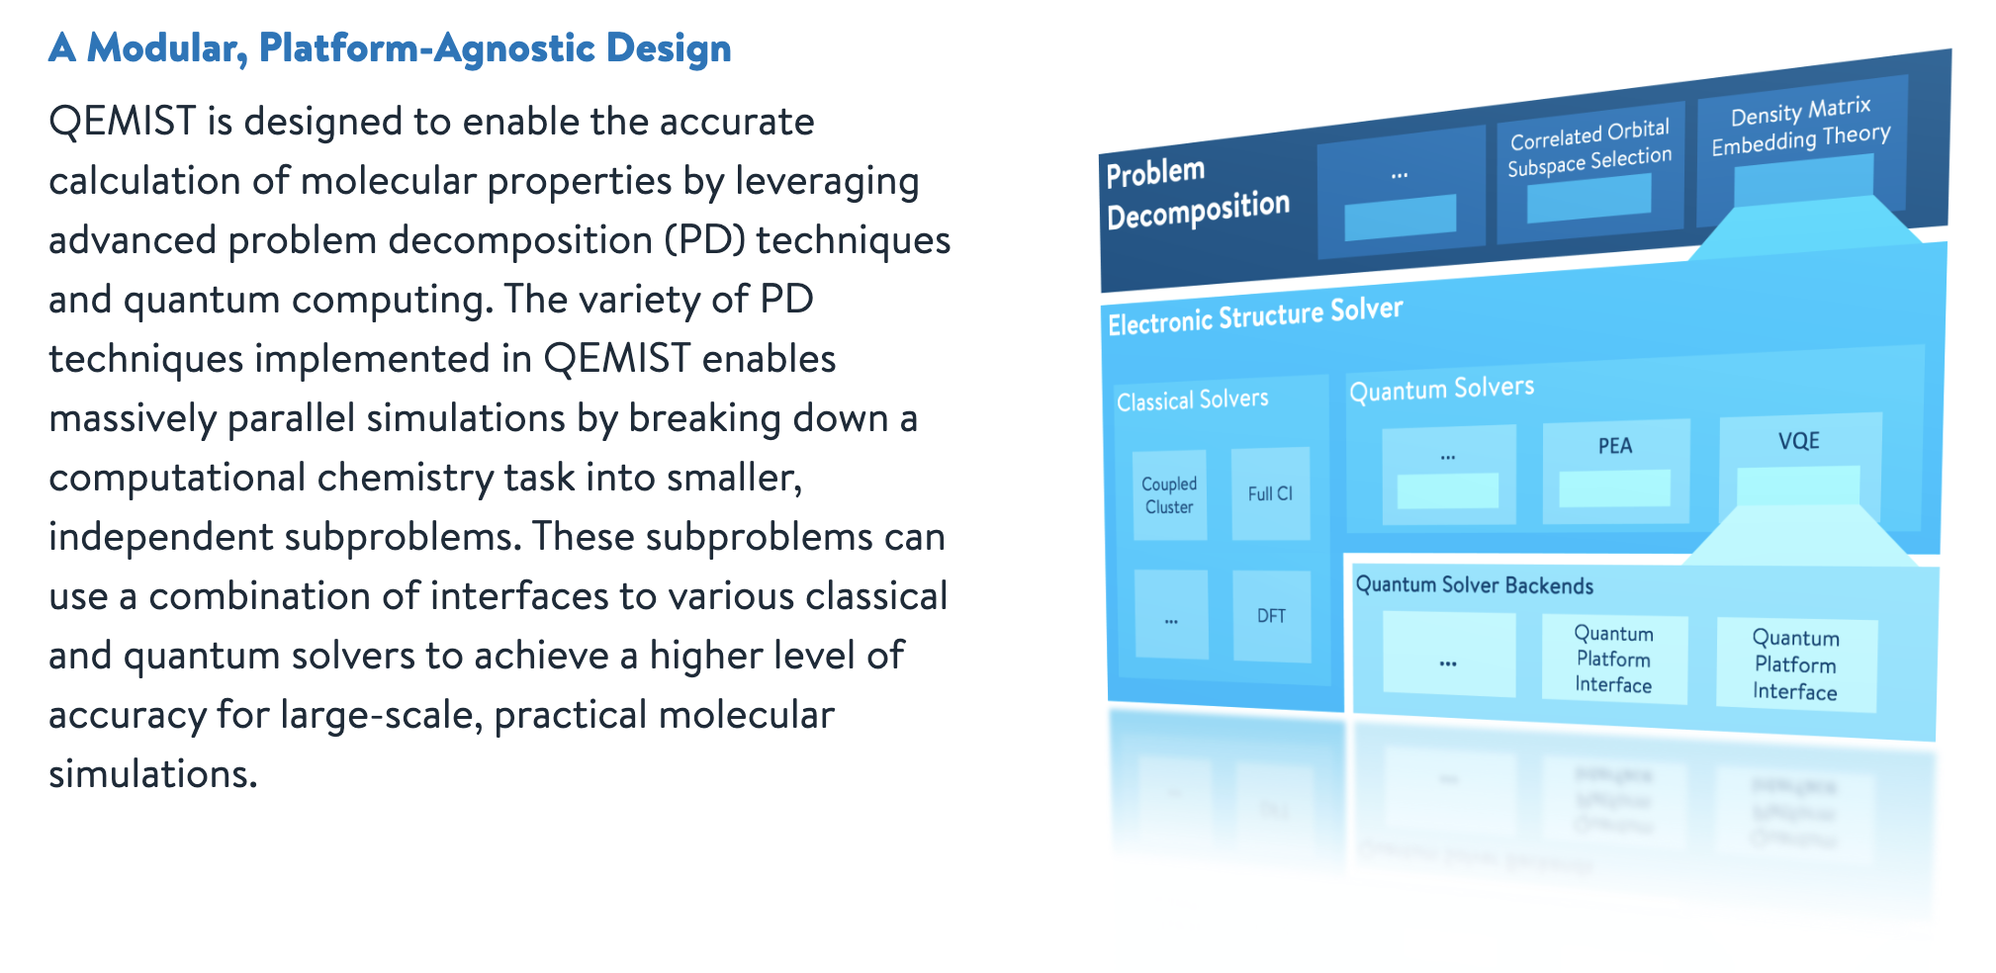
1Qbit Qemist

Slide 21
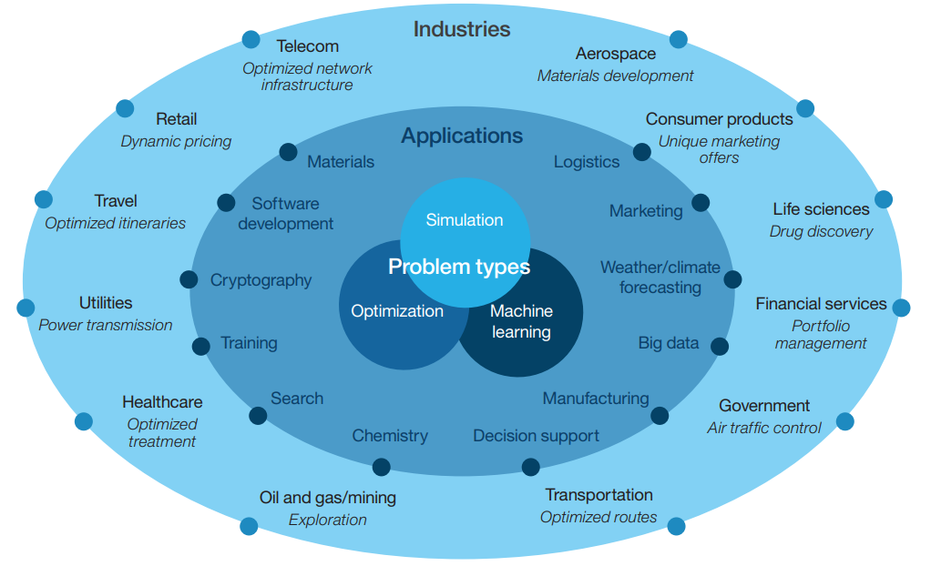
Quantum’s potential impact on problem-solving for applications and industries
Taking the Quantum Leap – Why Now?
www.ibm.com/thought-leadership/institute-business-value

Slide 22

British Columbia Institute for Quantum Algorithms
https://archive.news.gov.bc.ca/releases/news_releases_2017-2021/2019PREM0111-001892.htm

Slide 23
British Columbia Institute for Quantum Algorithms — Quick Facts
$17 million for five years to establish the Quantum Algorithms Institute
Quantum Algorithms Institute (QAI) will focus on building software and algorithms
Help advance QC from research through to “transformative” technology
Universities: SFU, UBC, UVic, Thompson Rivers University, Kwantlen University
Local QC companies, like D-Wave and 1Qbit
QC world leaders like Microsoft and IBM
Commercially active QC companies: D-Wave, 1Qbit, IBM, Microsoft, Fujitsu
Physical Office at SFU to help develop new Surrey downtown Vancouver
Support Cascadia corridor — BC, Washington, Oregon
Connect to Pacific Northwest Quantum Nexus — UW, PNNL, Microsoft

Slide 24
UVic Quantum Research Cluster
CRC in Quantum Systems — CSC & ECE, Engineering
CRC in Quantum Computing for Simulation of Molecules and Materials— Chem & Phys-Astro, Science
Chair in Quantum Devices — ECE/ Phys-Astro, Engr/Science
24

Slide 25
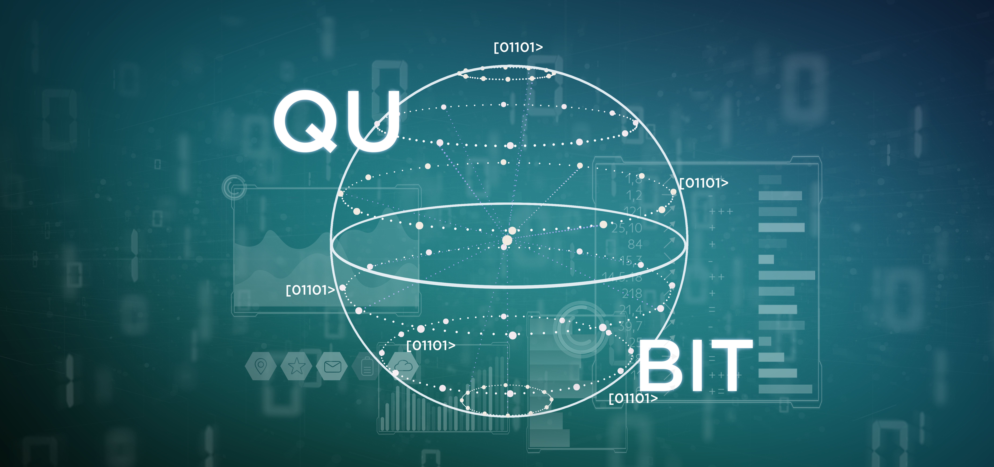
Quantum Problem Solving & Algorithm Design 3-Year IBM CAS Project
Principal investigators: Ulrike Stege, Hausi Müller, Priya Angara
Develop a toolkit to identify quantum problems and quantum hybrid problems
Develop quantum problem solving & algorithm design techniques for selected application domains
Develop quantum software for selected problems using IBM Qiskit open-source quantum computing framework
25

Slide 26
UVic Quantum Computing Training
PHYS 280: Special Topics in Physics: Introduction to Quantum Computation Spring 2020 by Rogério de Sousa
Directed Studies and Grad Course in Quantum Computing — Stege, Müller
Quantum Fundamentals & Qiskit Programming — Qiskit Terra & Aqua (Fall 2020)
Quantum Algorithms & Problem Solving — Qiskit Aqua (Spring 2021)
Topics Courses in Quantum Applications — Quantum Molecular Chemistry — Paci
Quantum Computing Distance Course for TRU — Tiedje
HighTechU Quantum Computing Component — Stege
Hands-on courses on IBM Qiskit and D-Wave D-leap development platforms as part of NSERC CREATE training program 2020
26

Slide 27
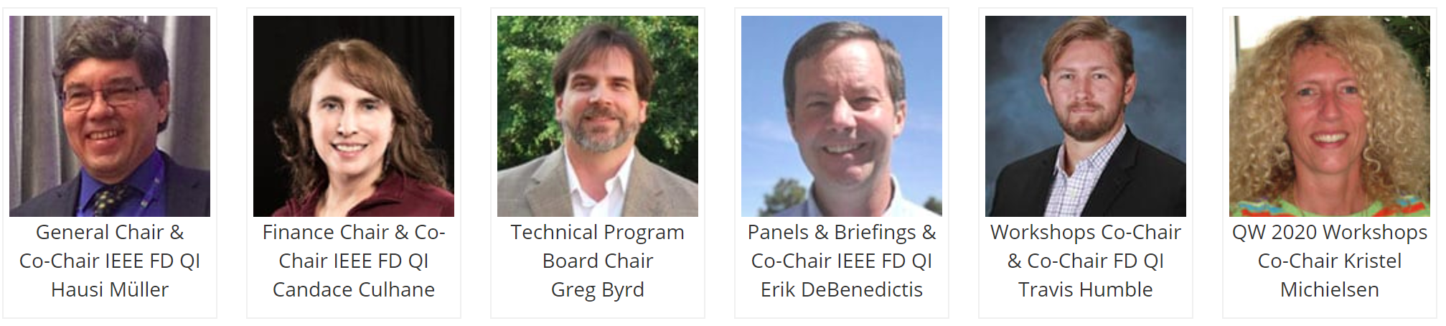
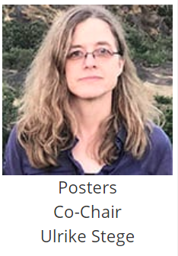
You are cordially invited to contribute and attend
IEEE Quantum Week 2020
Oct 12-16, 2020 Denver – Broomfield, USA
qce.quantum.ieee.org

Slide 28
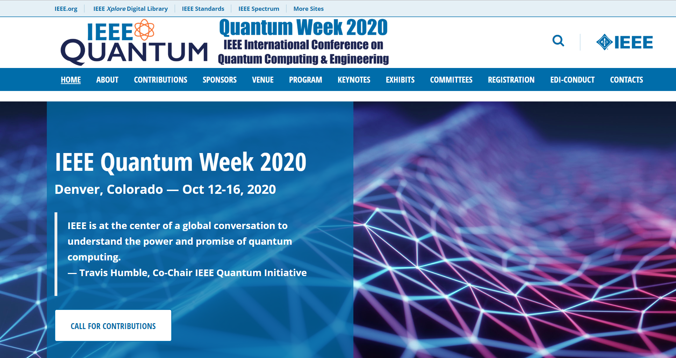

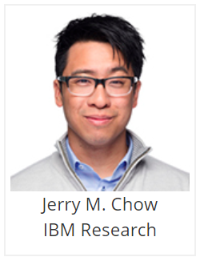
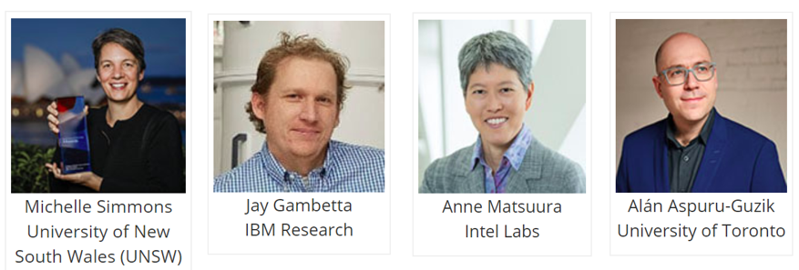
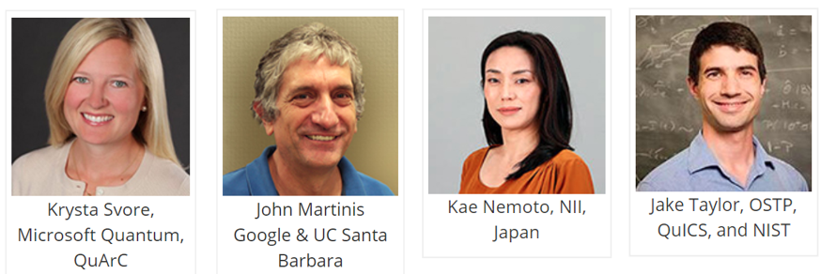
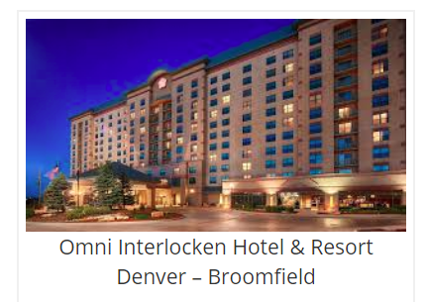
Keynote Speakers
twitter.com/IEEEQuantumWeek
qce.quantum.ieee.org

Slide 29
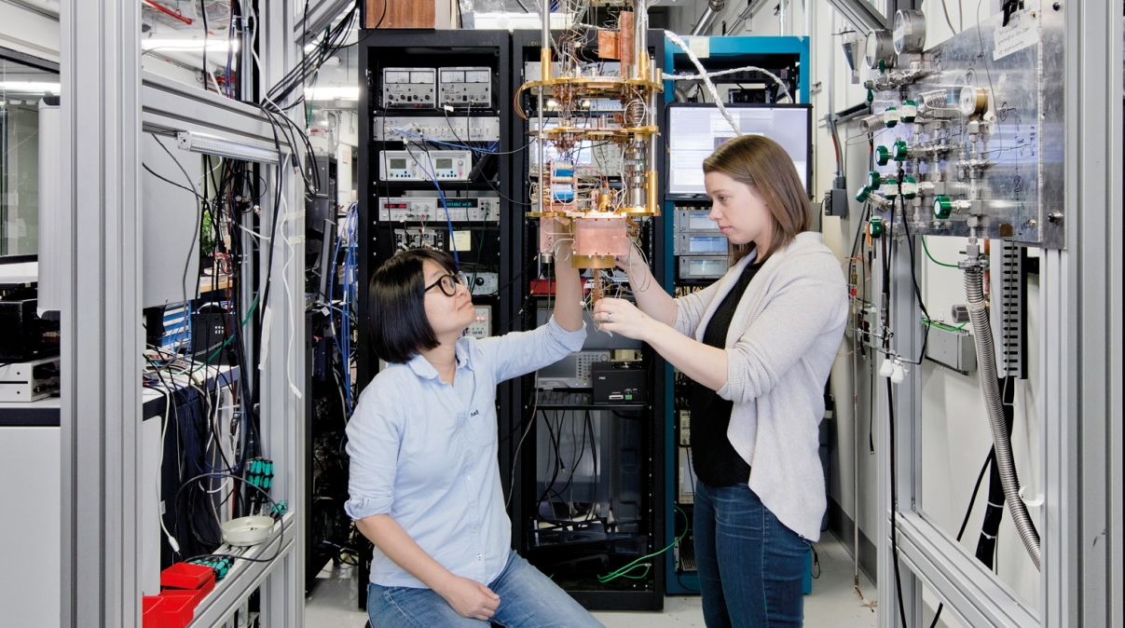
Quantum Computing!
IBM Quantum Computing Scientists Hanhee Paik (left) and Sarah Sheldon (right) examine the hardware inside an open dilution fridge at the IBM Q Lab at IBM’s T. J. Watson Research Center in Yorktown, NY.
Notes:
IBM Quantum Computing Scientists Hanhee Paik (left) and Sarah Sheldon (right) examine the hardware inside an open dilution fridge at the IBM Q Lab at IBM’s T. J. Watson Research Center in Yorktown, NY.

Slide 30
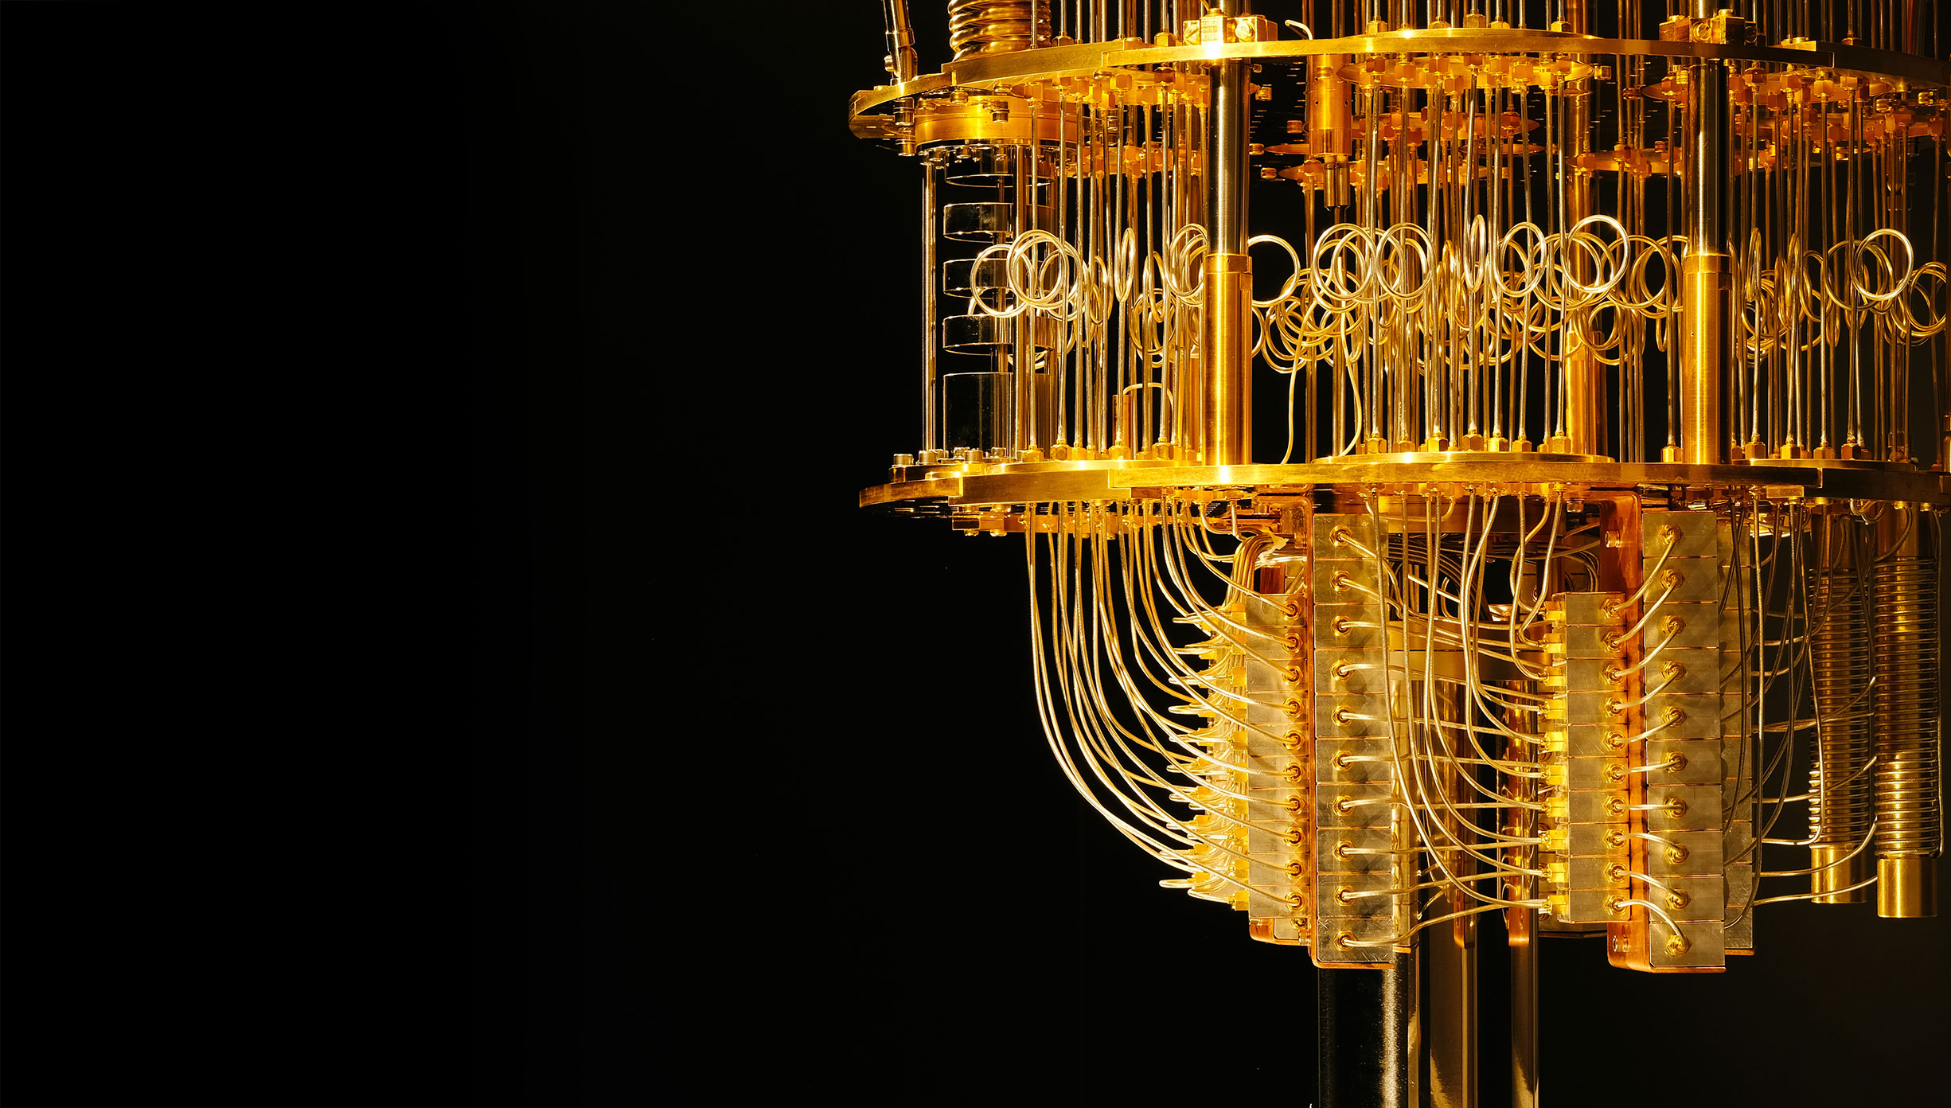
Quantum computing devices
https://quantum-computing.ibm.com/
Circuit Composer
https://quantum-computing.ibm.com/composer
Qiskit
https://qiskit.org/
Shtetl-Optimized
https://www.scottaaronson.com/blog/

Slide 31
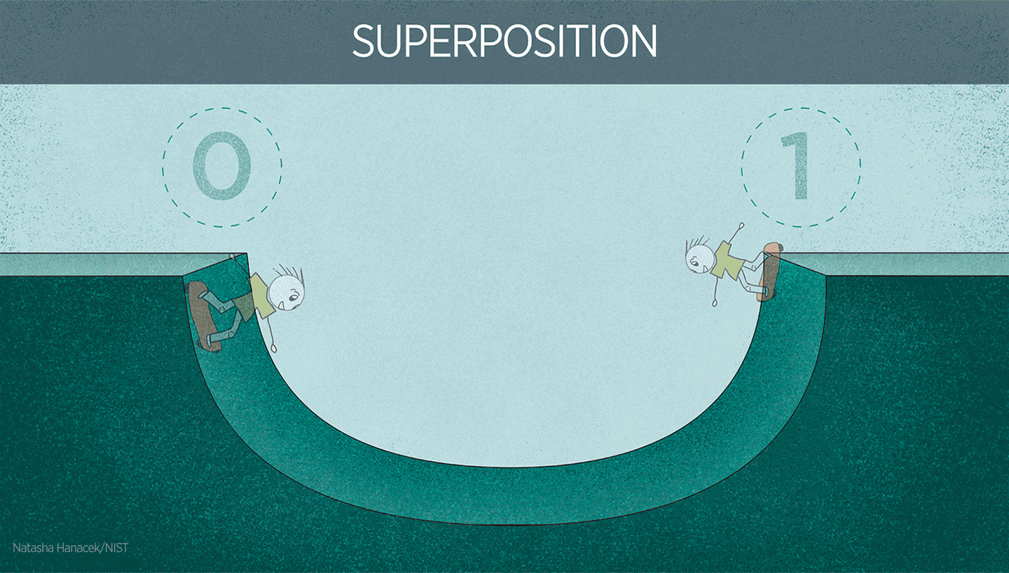
In the ordinary classical world, a skateboarder could be in only one location or position at a time, such as the left side of the ramp (which could represent a data value of 0) or the right side (representing a 1). But if a skateboarder could behave like a quantum object (such as an atom), he or she could be in a “superposition” of 0 and 1, effectively existing in both places at the same time.
Notes:
https://www.nist.gov/image/superpositiongif

Slide 32
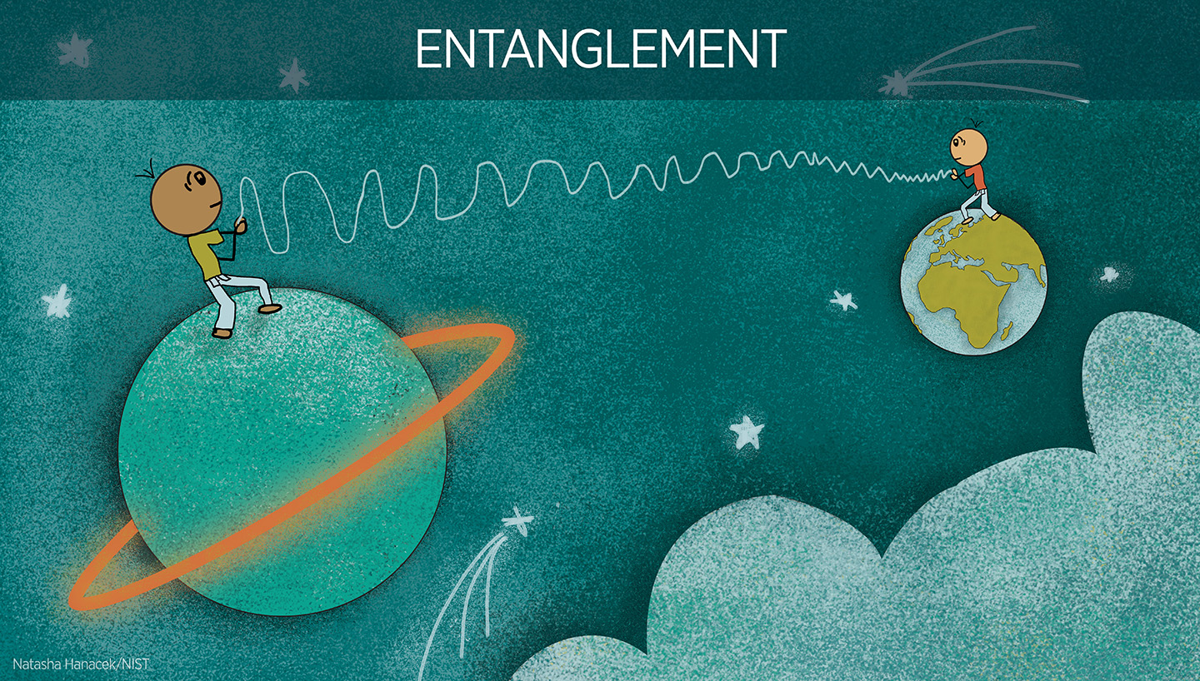
In the quantum phenomenon known as entanglement, the properties of two particles are intertwined even if they are separated by great distances from each other.
Notes:
https://www.nist.gov/image/entanglementrevjpg

Slide 33
Today’s Agenda
Starting Time Approximate | Topic
9:00 | Introduction and Motivation
9:30 | Account setup on IBM Q Experience
10:00 | Break
10:15 | Introduction to Jupyter Notebooks, Python, Qiskit
11:00 | Qubits, gates, superposition and measurements
12:30 | Lunch
1:00 | Hands-on programming
2:30 | 2-qubit systems and entanglement
3:30 | Break
3:45 | Entanglion
4:45 | Closing & Feedback

